Slide 1
Your elevator pitch has one job.
Get the next question.
Mariam Tariq
Product & GTM executive
Author • Speaker
How to use AI to get started, think harder and refine your message — without sounding like AI.
The Unwritten Rules
for Getting Ahead at Work
MARIAM TARIQ
Notes:
~1.5 min. An elevator pitch is not a compressed brochure. Its job is to create enough relevance and curiosity to get the next question. Tell them you will show a real example, including the messy middle.

Slide 2
Your Experience Using AI
ASK
CREATE
REFINE
Have you used ChatGPT or another AI assistant
to ask a question?
Have you used AI in a tool like Canva or PowerPoint
to create something?
Have you gotten an AI result and thought,
“That’s not quite right”?
or “That doesn’t sound like me.”
MARIAM TARIQ
Notes:
~1.5 min. An elevator pitch is not a compressed brochure. Its job is to create enough relevance and curiosity to get the next question. Tell them you will show a real example, including the messy middle.

Slide 3
What is an elevator pitch?
A brief, 30–60 second introduction that explains who you are, what you do or what your idea is —
in a way that makes someone want to know more.
CLEAR
CONCISE
COMPELLING
They immediately understand
what you do.
Give them what matters —
not everything you know.
Give them a reason to
ask another question.
Networking • Prospective customers • New ideas • Investors • Interviews
A good elevator pitch leaves them wanting to know more.
MARIAM TARIQ
Notes:
Ground the audience first. An elevator pitch is a short introduction, usually 30–60 seconds. It can be about you, a business, product or idea. The goal is to create enough interest to continue the conversation.

Slide 4
Build it from the listener backward.
WHO
PAIN
VALUE
PROOF
NEXT
Who am I talking to?
What matters / hurts?
What changes?
Why believe me?
What invites dialogue?
The same business may need more than one elevator pitch.
WHO means both who you serve and who is standing in front of you.
MARIAM TARIQ
Notes:
~1.5 min. This is a thinking framework, not a script formula. The same company can need different pitches for a customer, referral partner, investor or employee.

Slide 5
What makes a good elevator pitch?
SHORT
RELEVANT
SPECIFIC
CONVERSATIONAL
Aim for 20–30 seconds.
Earn more time.
Start with what matters
to this listener.
Problem, value, outcome.
Skip the buzzwords.
Say it like you talk.
Don’t memorize a paragraph.
MARIAM TARIQ
Notes:
Start short and earn more time. An elevator pitch may run 30–60 seconds, but in many networking situations, starting closer to 20–30 seconds gives the listener room to engage and lets you earn the rest of the conversation.
Know the pieces rather than memorizing every word. Understanding the listener, pain, value, proof and next step makes it easier to adapt naturally to the person in front of you.
Practice out loud. Language can look great on a screen and sound ridiculous when you say it. If you stumble over a phrase, rewrite it in words you would actually use.
Leave room for the next question. The goal is to spark enough interest for someone to ask more, rather than trying to tell them everything at once.

Slide 6
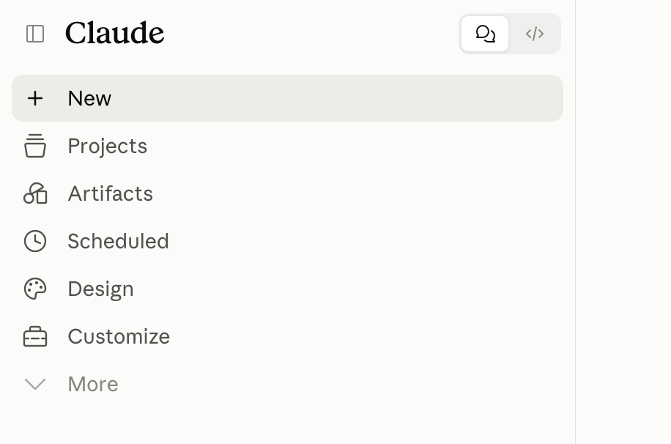
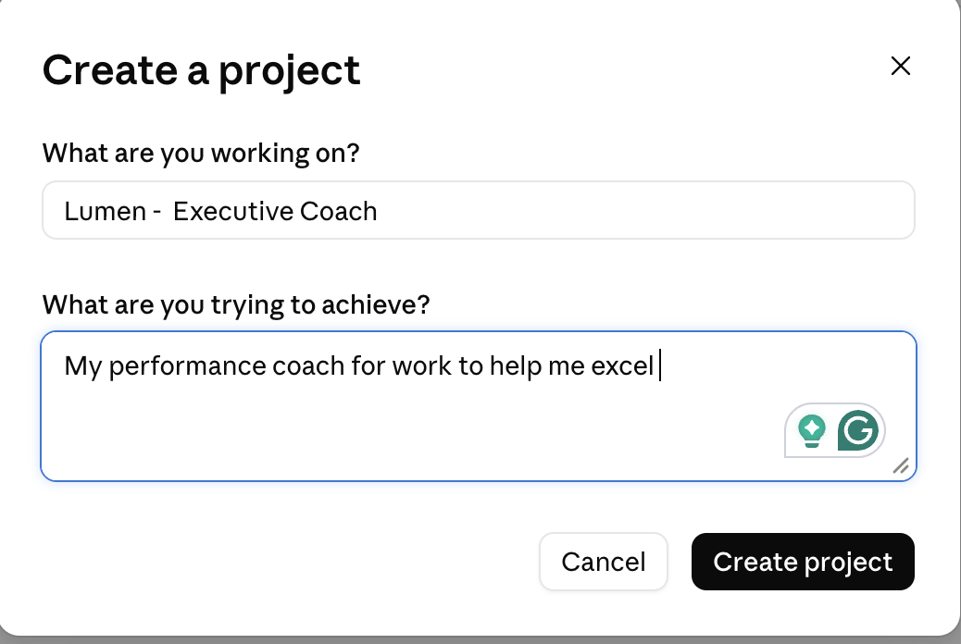
Using AI - Use a Project in your LLM of Choice
MARIAM TARIQ
Notes:
Start short and earn more time. An elevator pitch may run 30–60 seconds, but in many networking situations, starting closer to 20–30 seconds gives the listener room to engage and lets you earn the rest of the conversation.
Know the pieces rather than memorizing every word. Understanding the listener, pain, value, proof and next step makes it easier to adapt naturally to the person in front of you.
Practice out loud. Language can look great on a screen and sound ridiculous when you say it. If you stumble over a phrase, rewrite it in words you would actually use.
Leave room for the next question. The goal is to spark enough interest for someone to ask more, rather than trying to tell them everything at once.

Slide 7
Where AI actually helps – Get Off the Blank Page.
BRAINSTORM
CHALLENGE
REFINE
Give me ways into the story.
What am I missing?
What sounds generic,
unclear or irrelevant?
Make it shorter, clearer
and right for this audience.
Don’t ask AI to think instead of you.
Give it something to think with.
MARIAM TARIQ
Notes:
~1.5 min. Introduce AI only after the audience understands the pitch. AI is useful for brainstorming, challenging and refining. It is especially useful because reacting to something is often easier than starting from nothing.
Give AI context before you give it a task. In the Luna example, I didn’t simply type, “Write me an elevator pitch.” I gave AI information about the audience, the product, what I already knew, and what I was trying to accomplish. Better context produces better material to work with.

Slide 8
DO / DON’T
AI gives you a starting point — not the finished pitch.
DO
DON’T
• Give it your raw ideas
• Give it context about the listener
• Ask it to interview you
• Ask for options
• React, edit, test out loud, repeat
• Blindly copy the first answer
• Let AI invent facts or proof
• Assume polished = good
• Keep words you wouldn’t say
• Expect one magic prompt
AI gives you something to react to instead of a blank page.
MARIAM TARIQ
Notes:
~2 min. Make this personal: I use AI a lot and almost never take the first answer. I may spend a lot of time editing. That is not failure. The value is having something to react to.

Slide 9
THE AI SMELL TEST
Can you tell AI wrote it?
Tells I catch
My human test
• Consulting-sounding titles
• “It’s not X — it’s Y” everywhere
• Everything comes in a perfect set of three
• Transform / unlock / empower / innovative
• Too many em dashes and polished transitions
• Would I actually say this?
• Could anyone in my industry say it?
• Is there a real example behind the claim?
• Can I make it simpler?
• Does it sound like me?
Use AI to brainstorm. Don’t outsource your judgment.
MARIAM TARIQ
Notes:
~2 min. These are patterns you personally catch in AI drafts. No blind copy-and-paste. A polished sentence can still be generic or unlike you.

Slide 10
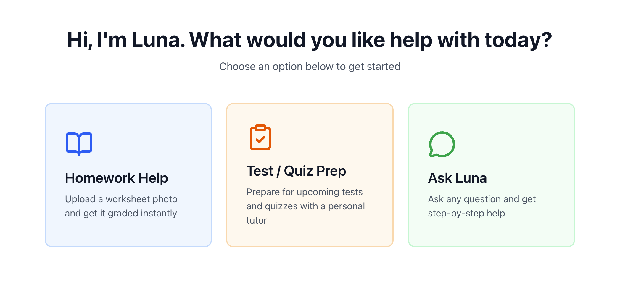
My Example
I’m preparing to introduce my app called Luna Tutor to the Superintendent of Fairfax County Public Schools.
MARIAM TARIQ
Notes:
~30 sec. Transition: Rather than give you more prompts, let me show you what this looks like on something I am actually building.

Slide 11
LUNA: RAW MATERIAL
Start with what I know.
MY NOTES — NOT MY PITCH
This is my raw material.
• AI tutor for students learning at home
• Makes it easier for busy parents to support their kids
• Built by a mom and tested by kids
• Designed for tutoring—not general-purpose chat
• Gets to know the student and builds over time
• More control over correctness for the math it supports
AI comes after I’ve done
some thinking myself.
MARIAM TARIQ
Notes:
~1.5 min. These are your rough thoughts. The point is to show that you bring the substance. AI is not inventing what Luna is.

Slide 12
WHO AM I TALKING TO?
Same Luna. Different listener.
SUPERINTENDENT
PARENT
STUDENT
INVESTOR
learning outcomes
responsible AI
parent support
trust
confidence
help at home
less friction
help me understand
remember me
don’t just answer
market need
differentiation
defensibility
For this meeting, my WHO is the superintendent.
MARIAM TARIQ
Notes:
~1 min. The product did not change. The listener did. For this walkthrough, focus on the superintendent.

Slide 13
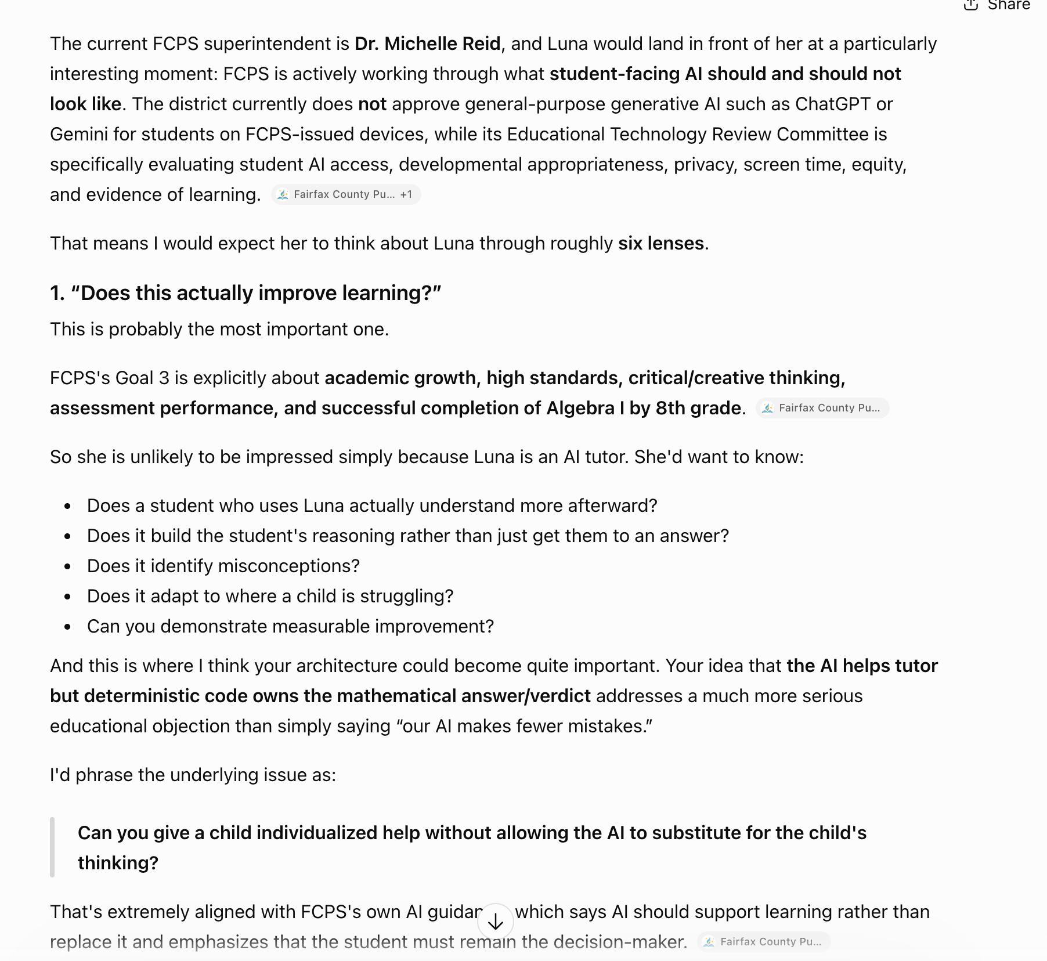
USE AI TO LEARN
Before I write, I learn about the listener.
MY PROMPT
SCREENSHOT 1
I’m preparing to introduce Luna, an AI tutor for middle-school students, to the superintendent of Fairfax County Public Schools.
Before helping me write anything, help me understand the superintendent’s likely priorities. What would she care about? What concerns would she have? What would she be skeptical of?
Paste real AI response from your Luna project
MARIAM TARIQ
9
Notes:
~1.5 min. This is brainstorming, not truth. Verify factual assumptions. You are using AI to get outside your own point of view.

Slide 14
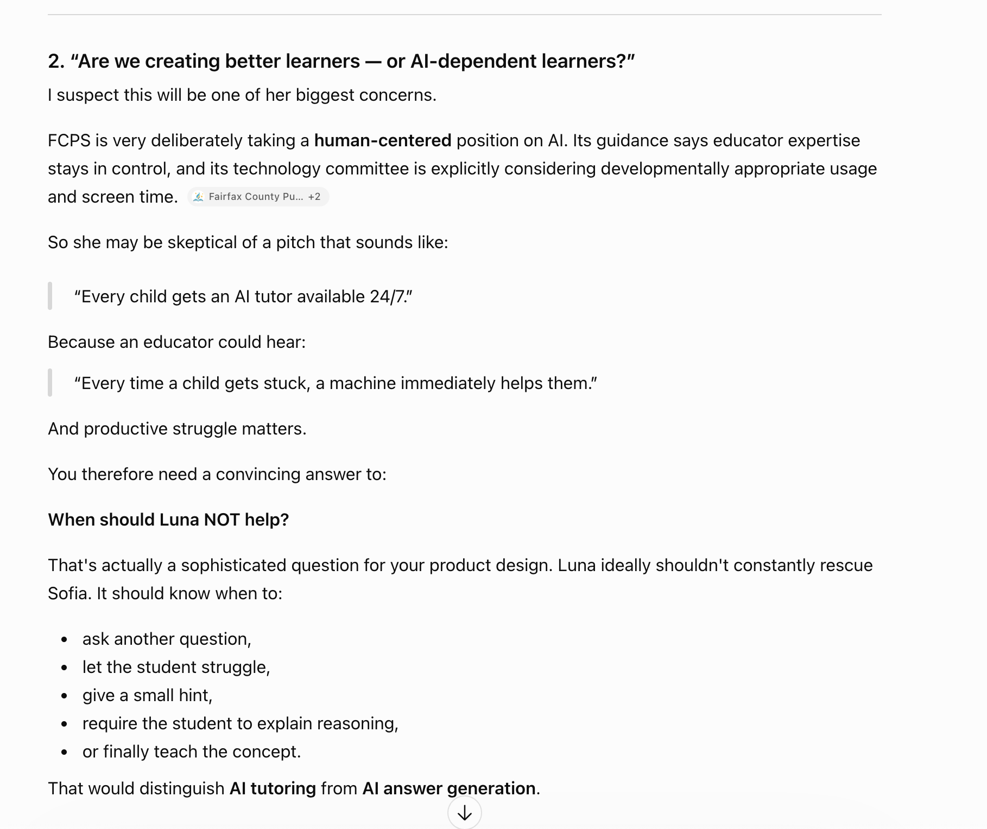
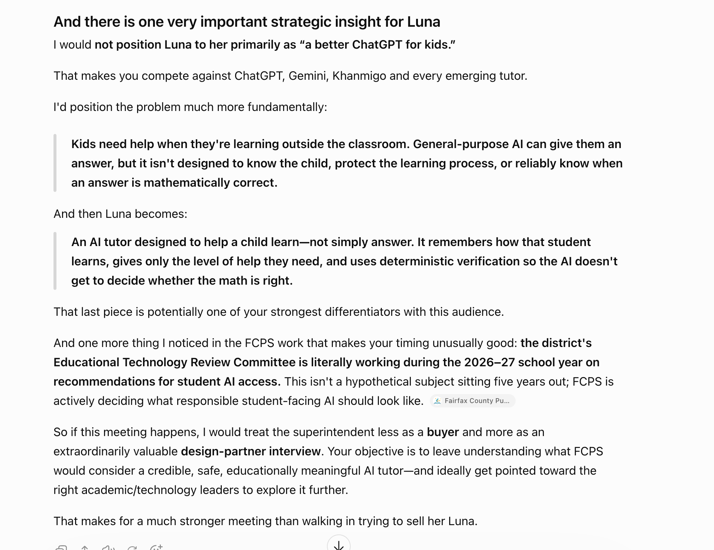
USE AI TO LEARN
MARIAM TARIQ
Notes:
~2 min. This is brainstorming, not truth. Verify factual assumptions. The value is getting beyond your own point of view before writing.

Slide 15
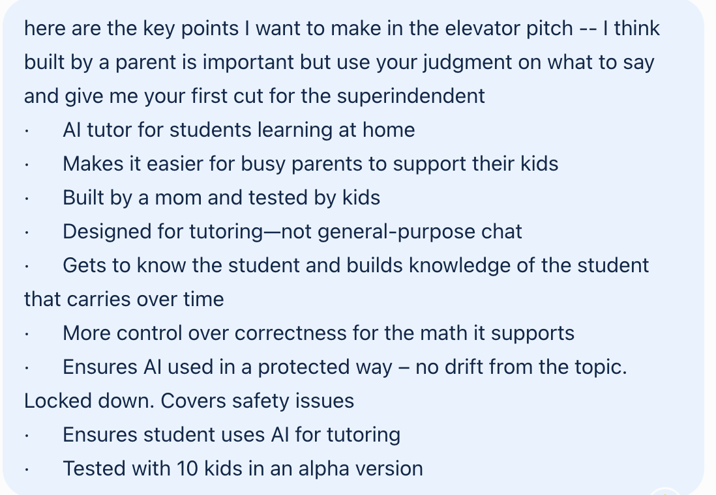
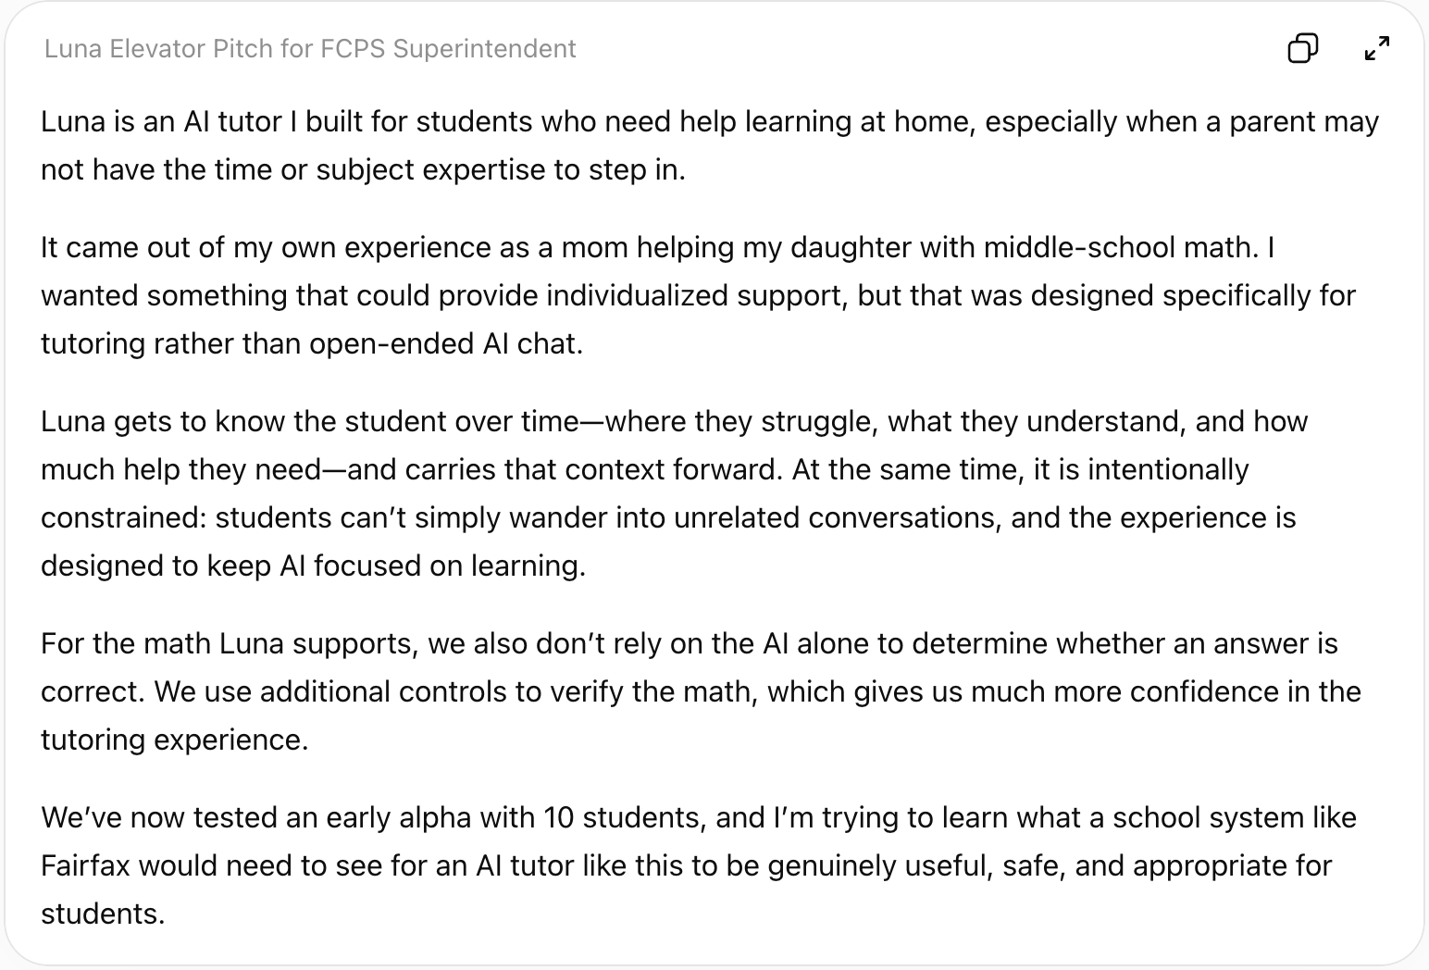
NOT ONE MAGIC PROMPT
Give AI something to work with
SCREENSHOT 2
SCREENSHOT 3
Your raw input + AI questions
→
First draft / AI response
→
The useful part is having something to react to.
MARIAM TARIQ
10
Notes:
~2 min. Narrate your actual edits: not me, too generic, keep this, you missed the point. This is the practical reality of using AI well.

Slide 16
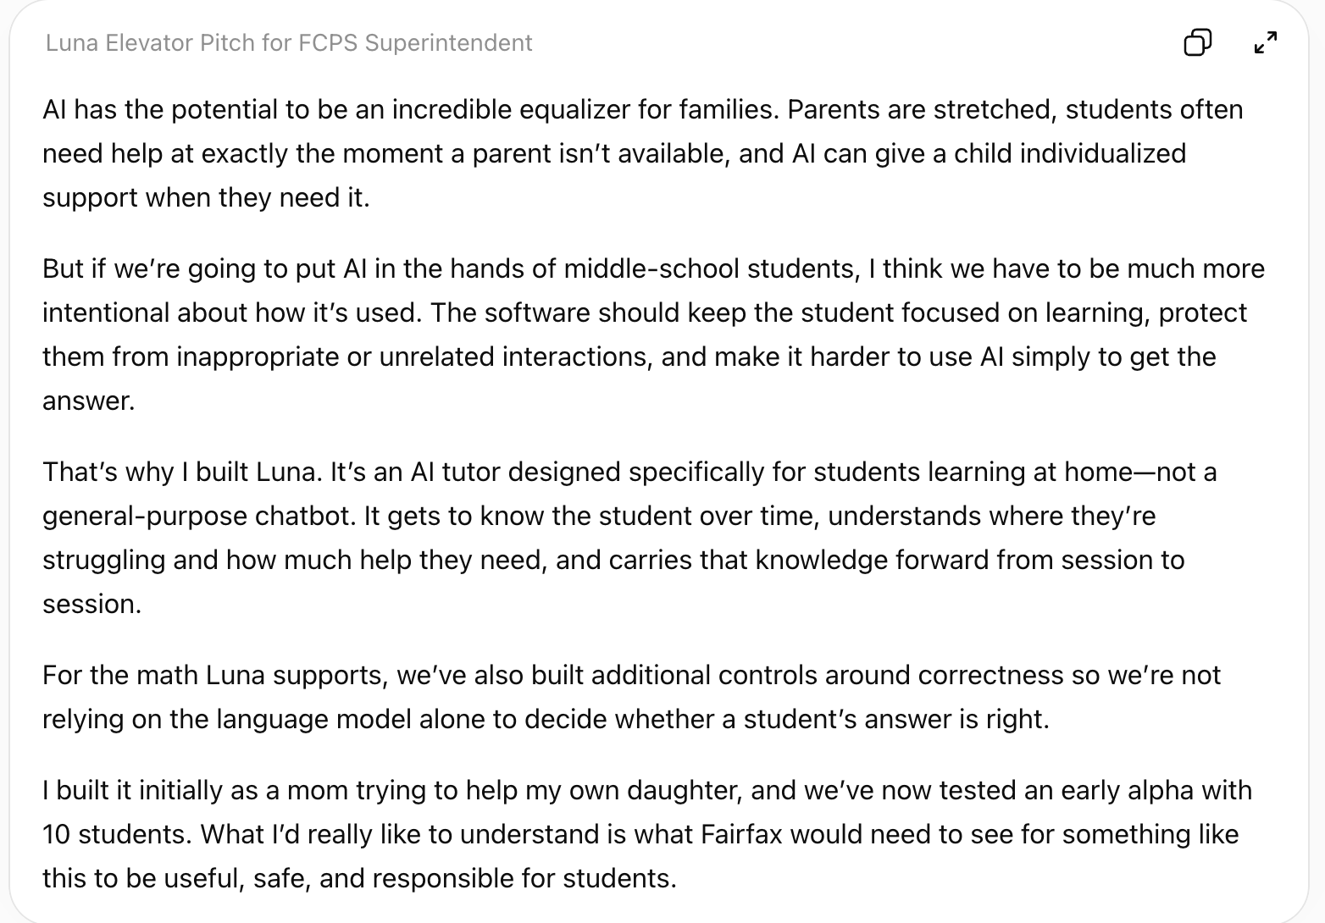
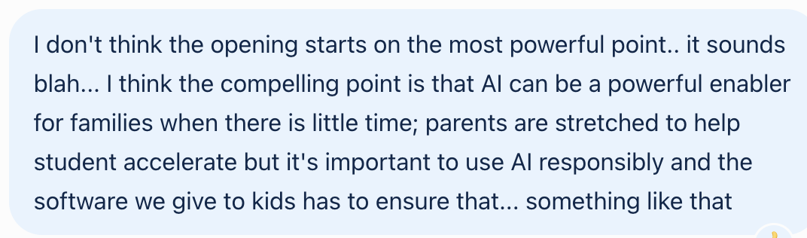
NOT ONE MAGIC PROMPT
React. Push back. Refine.
SCREENSHOT 2
→
Your raw input + AI questions
→
MARIAM TARIQ
The useful part is having something to react to.
Notes:
~2 min. Narrate your actual edits: not me, too generic, keep this, you missed the point. This is the practical reality of using AI well.

Slide 17
APPLY THE SMELL TEST
Now I catch the AI.
Luna isn’t just another AI tutor—it’s a personalized learning companion designed to transform the at-home learning experience.
By combining intelligent personalization, persistent memory, and accuracy-focused technology, Luna meets every student where they are and empowers them to learn with confidence.
Built by a mom and tested by real students, Luna helps bridge the gap between classroom learning and at-home support—giving students the help they need and parents the peace of mind they deserve.
What I would mark up
• Words I would never say
• Generic claims
• Over-polished constructions
• Anything that sounds like a consulting deck
• Anything that obscures the actual point
If it sounds generated, I keep working.
MARIAM TARIQ
Notes:
~1.5 min. Call back to the earlier AI smell test. This makes the general advice concrete.
This is perfect for your “AI Smell Test” slide because you can mark it up:
“isn’t just X—it’s Y” → classic AI construction
“personalized learning companion” → consultant/marketing language
“designed to transform…” → transform is an AI favorite
“combining intelligent personalization, persistent memory, and accuracy-focused technology” → suspiciously neat rule of three
“meets every student where they are” → cliché
“empowers them” → AI buzzword
“bridge the gap” → generic business phrase
“the help they need / peace of mind they deserve” → overly polished parallel construction
And the biggest problem: it makes Luna sound like every other AI education product.
You could literally put the paragraph on the left and your handwritten-style annotations on the right:
“I wouldn't say this.”
“What does this actually mean?”
“Generic.”
“AI loves this construction.”
“Claim is too broad.”
Then reveal the bigger lesson:
The problem isn't that the writing is bad.
The problem is that it sounds good without saying enough.
That's exactly the distinction I think you want the business owners to understand.
what is —
That symbol — is an em dash.
There are three common dash-like marks:
Hyphen: - — connects words, e.g. AI-powered
En dash: – — often indicates a range, e.g. 30–60 seconds
Em dash: — — creates a break in a sentence, like this: Luna helps students learn—not simply get answers.
And yes, the em dash is one of the “AI tells” you were thinking of. AI tends to use them much more frequently than most people naturally do.

Slide 18
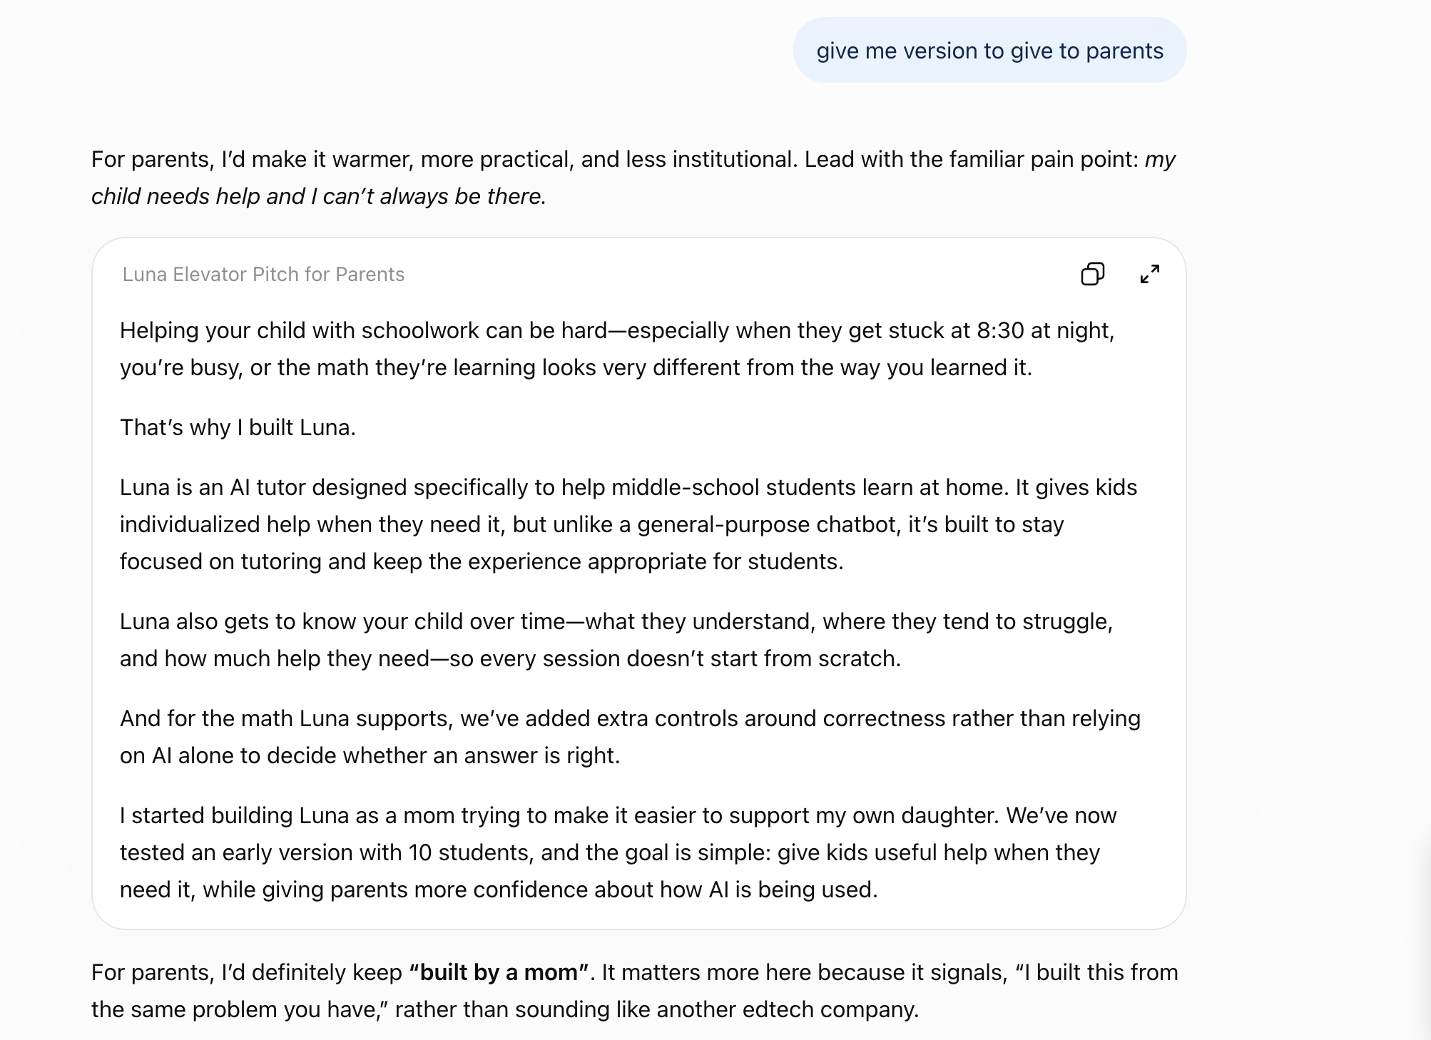
THE PAYOFF
Same product. Different audience
MARIAM TARIQ
12
Notes:
~1.5 min. Read one or two, not all four. Close: AI did not invent my story. It helped me decide which parts mattered to this listener and gave me something to react to and refine. Return to the opening: the goal is the next question. Then Q&A.

Slide 19
Do You Need to Pay for AI?
AI Tool
Free Version
Paid Version
My Recommendation
ChatGPT
★ Best first upgrade for regular users
✓
ChatGPT Plus
Claude
Upgrade if you write a lot
✓
Claude Pro
Microsoft Copilot
Best if your organization already uses Microsoft 365
✓
Copilot Pro
Canva
Upgrade only if you create visuals regularly
✓
Canva Pro
Typical paid plans are about $20/month (USD). Microsoft Copilot pricing varies depending on your Microsoft 365 subscription.
Notes:
~1.5 min. Read one or two, not all four. Close: AI did not invent my story. It helped me decide which parts mattered to this listener and gave me something to react to and refine. Return to the opening: the goal is the next question. Then Q&A.

Slide 20
AI Is a Thinking Partner
Don’t Use AI To
Use AI To
✕
Write your material verbatim
✓
Challenge your ideas
✕
Replace your thinking
✓
Improve organization
✕
Be your voice
✓
Strengthen messaging
✓
Practice presentations
✓
Improve clarity
If it doesn’t sound like you... don’t use it.
Notes:
~1.5 min. Read one or two, not all four. Close: AI did not invent my story. It helped me decide which parts mattered to this listener and gave me something to react to and refine. Return to the opening: the goal is the next question. Then Q&A.

Slide 21
Five Principles to Remember
1
2
3
4
5
Start with people—not prompts.
Understand your audience before creating content.
Use AI to improve your thinking—not replace it.
Keep your own voice.
Start small and experiment.
Notes:
~1.5 min. Read one or two, not all four. Close: AI did not invent my story. It helped me decide which parts mattered to this listener and gave me something to react to and refine. Return to the opening: the goal is the next question. Then Q&A.

Slide 22
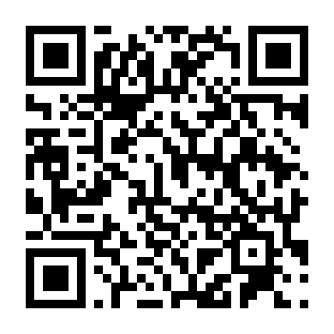
Get the deck
Deck plus the prompts you can use to build and refine your own elevator pitch.
Mariam Tariq
Technology Executive • Author • Speaker
SCAN FOR THE DECK + PROMPTS
mariamtariq.com
mariamtariq.com
linkedin.com/in/mariamtariq
Questions?
MARIAM TARIQ
Notes:
Closing / Q&A slide. Leave this on screen throughout the 10-minute Q&A. Say: “If you want the deck and the prompts I used today, scan the QR code. And feel free to connect with me on LinkedIn.”

